Slide 1
DS-306 Data Warehousing and Business Intelligence
Topic 7: Conceptual Data Warehouse Design
Dr. Khurram Shahzad

Slide 2
Design Specification & Process
The design process explains a procedure to design the process
It is a combination of art and science, but dominated by art…

Slide 3

General overview of the method
Data warehouse is a particular type of database dedicated to analytical purposes

Slide 4
Requirements specifications
Requirements specifications of DW differs significantly from operational system
In DW, requirement specification determines
  Which data should be available?
  How these data should be organized?
  Also, queries of interest are determined

Slide 5
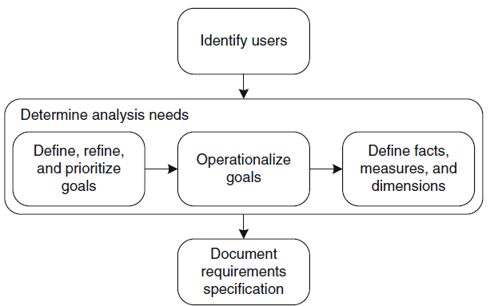
Analysis driven req. specification
The Framework
1
2
3

Slide 6
Analysis driven req. specification
1
Identify users/ Types of users
  Executive users
    Top organizational level
    Requires global summarized information
    They help understand goals and overall vision
  Management users
    Requires more detailed information pertaining to a specific area of organization
    Provide more insight into the process or tactics used for achieving business goals
  Professional users
    Responsible for specific section or services

Slide 7
Analysis driven req. specification
Identification of potential users should also consider different entities in a horizontal division of organization (departments)

Slide 8
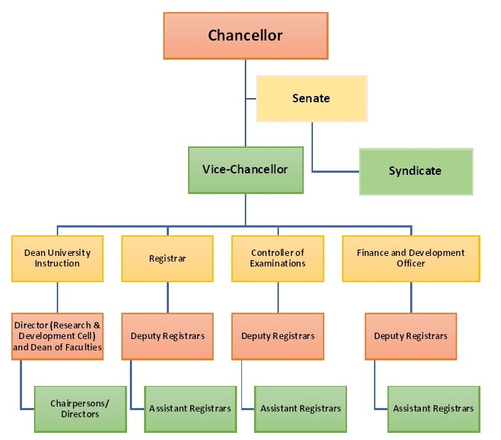
Organigram: Panjab University

Slide 9

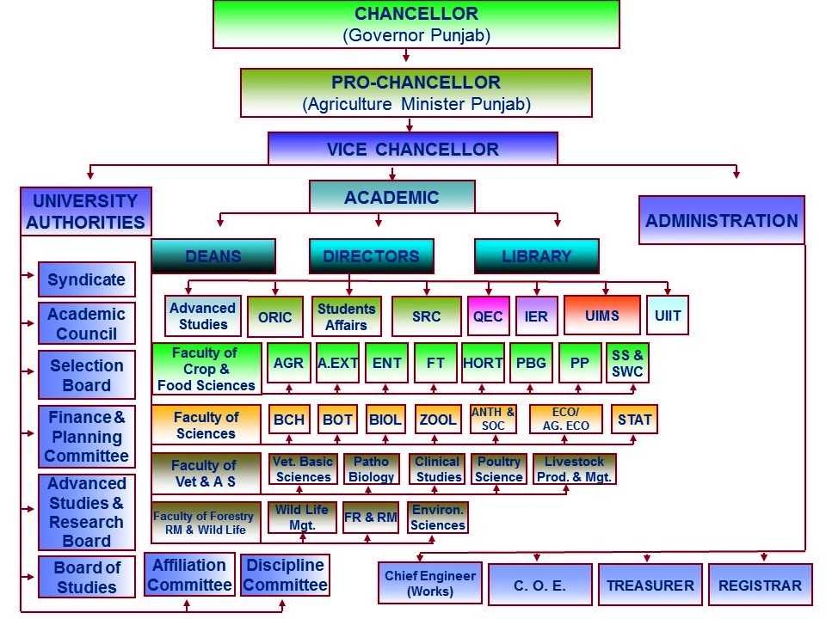


Slide 10

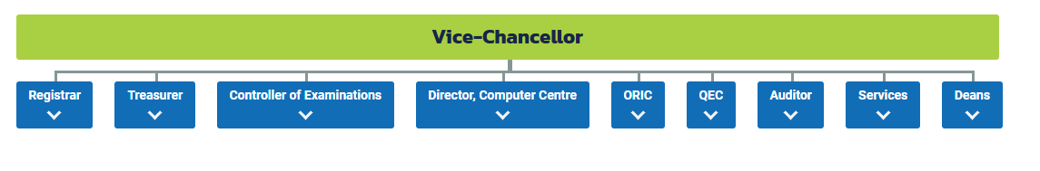
https://qau.edu.pk/organization-chart/

Slide 11
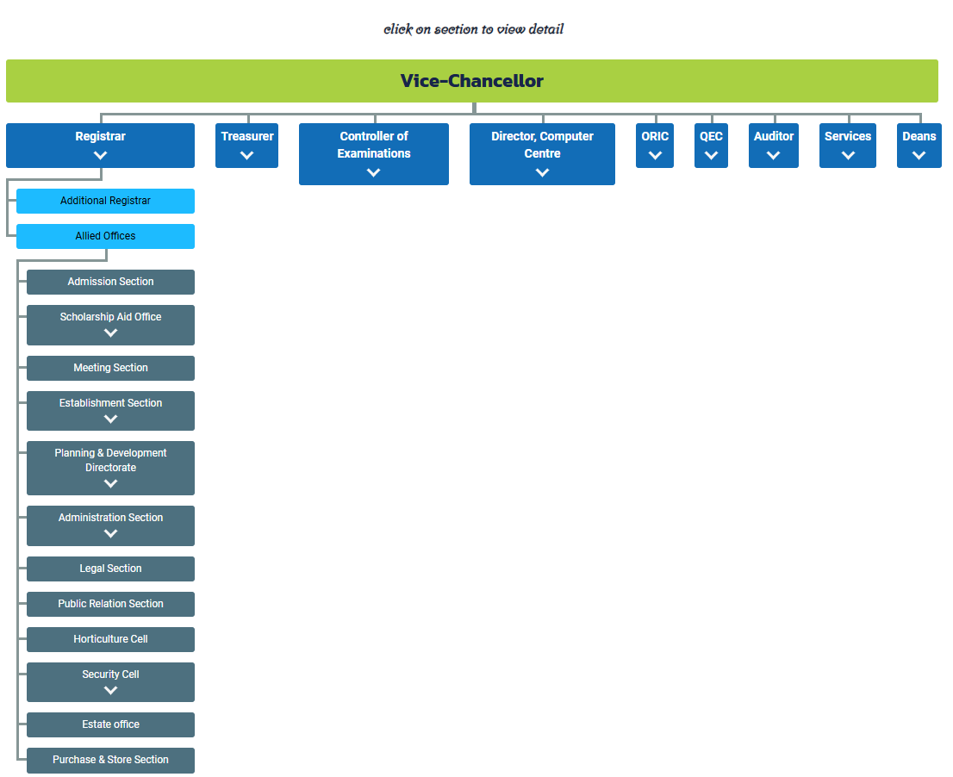

Slide 12
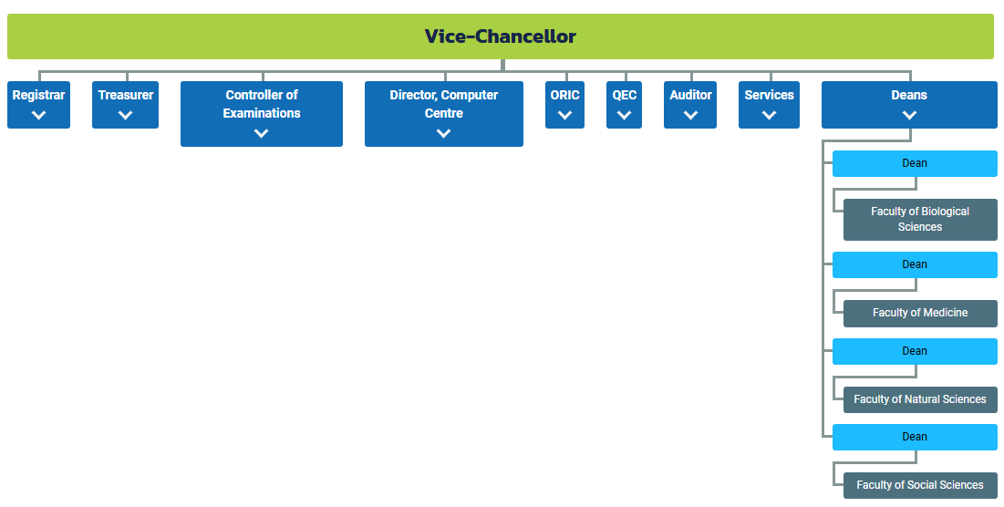

Slide 13
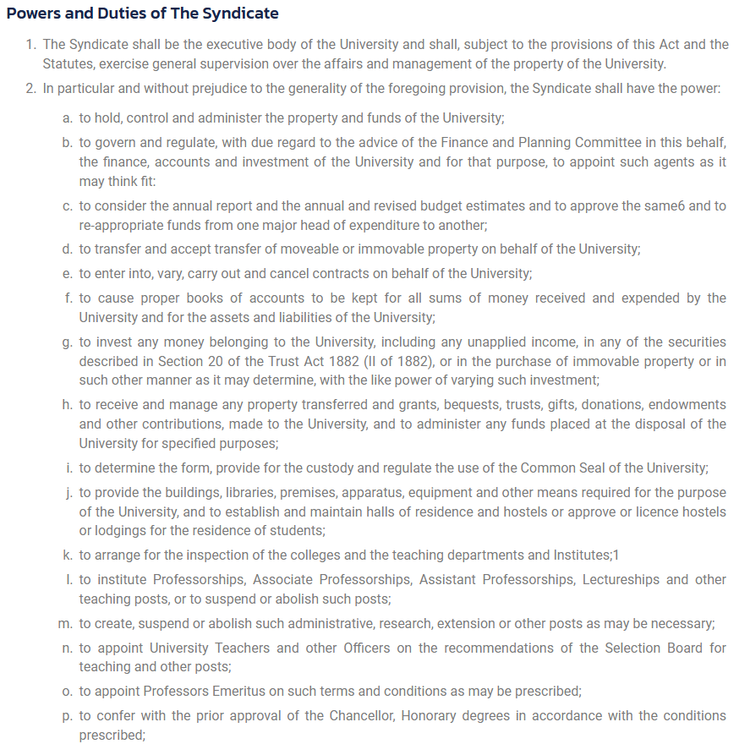

Slide 14
Analysis driven req. specification
1
2
3

Slide 15
Determine Analysis Needs
2
This phase helps users understand what data should be available to respond to users' expectations
Steps for Determining Analysis Needs
Define, Refine, Prioritize Goals
Operationalize Goals
Define Facts, Measures, and Dimensions

Slide 16
Determine Analysis Needs
2
Define, Refine and Prioritize Goals
  Develop a clear specification of the goals of a company
Two types of goals
  General goals
  Specific goals
Methods for gathering goals
  Conduct interviews and brainstorming sessions

Slide 17
Determine Analysis Needs: Define goals
2
Identify dependencies between goals
Prioritize goals
Identify supporting and conflicting goals
Analyze goals to detect redundancies
  Some goals could be combined due to similarity
  Some goals should be discarded because of inconsistency

Slide 18
Determine Needs: Operationalize goals
2
Make goals concrete
  By defining subgoals
For each goal, define measurement criteria (KPIs)
  Use interviews with users to identify it
Then, define representative queries
  Users define these queries
Each user provides list of queries needed for daily tasks

Slide 19
Determine Needs: Operationalize goals
2
Each user provides list of queries/reports needed for daily tasks
Disambiguate query terms
  For example, best customer
    Customer with highest total sales amount
    Customer with high margin, or ROI
    Customer with highest preference
Prioritize queries
Non-functional requirements can be included
  Response time, accuracy

Slide 20
Determine Needs: Define facts, dim
2
Manual process to define measures and dimensions
Analyst tries to identify the underlying facts and dimensions
Example: ‘top five customer names with monthly average sales higher than 1500$’
Data elements
  Customer name
  Month
  Sales

Slide 21
Analysis driven req. specification
1
2
3

Slide 22
Document requirement specification
3
Develop documentation
  Include all elements required by designers
  Dictionary of the terminology
  Organizational structure
  Policies
  And, constraints of the business

Slide 23
Example
3
Sample Data Warehouse Requirements Document

Slide 24
Northwind Case Study

Slide 25
1. Identify users
Executive:
  Members of the board of directors of NW who define overall company goals
Management
  Managers at department level, e.g. Marketing, regional sales, and human resources
Professional
  Personnel who implement indications of the management e.g. Marketing executive officers

Slide 26
2. Determine Analysis Needs
Increase the overall company sales by 10% yearly
Subgoals
  Increase sales in underperforming regions
  For customers buying below their potential, increase their orders
  Increase sales of products selling below the company expectations
  Take action on employees performing below their expectation

Slide 27
2. Determine Analysis Needs
Increase overall sales
by 10% yearly
Increase sales of
underperforming
regions
Increase sales of
Products selling
below expectations
Customer buying below
Potential, increase
their order
Take action
on employees
underperforming

Slide 28
2. Determine Analysis Needs
1. Increase sales in underperforming regions
  1a. Five best- and worst-selling (measured as total sales amount) pairs of customer and supplier countries.
  1b. Countries, states, and cities whose customers have the highest total sales amount.
  1c. Five best- and worst-selling (measured as total sales amount) products by customer country, state, and city.

Slide 29
2. Determine Analysis Needs
2. For customers buying below their potential, increase their orders
  2a. Monthly sales by customer compared to the corresponding sales (for the same customer) of the previous year.
  2b. Total number of orders by customer, time period (e.g., year), and product.
  2c. Average unit price per customer.

Slide 30
2. Determine Analysis Needs
3. Increase sales of products selling below the company expectations
  3a. Monthly sales for each product category for the current year.
  3b. Average discount percentage per product and month.
  3c. Average quantity ordered per product.

Slide 31
2. Determine Analysis Needs
4. Take action on employees performing below their expectation
  4a. Best-selling employee per product per year with respect to sales amount.
  4b. Average monthly sales by employee and year.
  4c. Total sales by an employee and her subordinates during a certain time period.

Slide 32
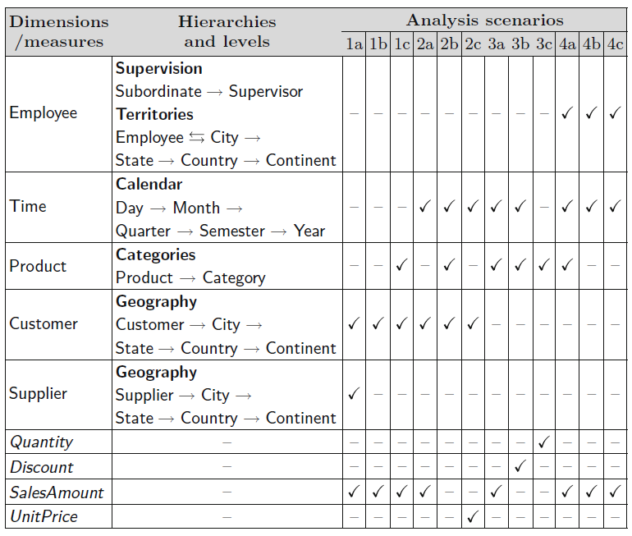
2. Determine Analysis Needs

Slide 33
3. Document requirements specification
The information includes the specifications of the users’ requirements
  Summarized information
  Explanation of each element
    Obtain it by interviewing users or administrative staff

Slide 34
Data Mart Design
The Inmon Approach

Slide 35
Design Specification & Process
The design process explains a step-by-step procedure to design the artifact
It is a combination of art and science, but dominated by art…

Slide 36
Designing Process of Star
Steps in Designing dim. modeling
  Step 1: Choose Business Process
  Step 2: Choose the Grain
  Step 3: Choose the Facts
  Step 4: Choose Dimensions
  Relationship between fact and dimensions

Slide 37
Step 1: Business Process
A major operational process in organization
Usually, is represented by a use-case diagram in operational source
Supported by legacy system
They are critical areas for the company
Reporting system plays an important role in identifying process
Are also called ‘subjects’
Difficult to decide its scope

Slide 38
Step 2: Granularity
Examples of different
grains and their impact
Determine level of detail
Grain is, unit of analysis
Grain varies with facts, it represents what individual fact table record as data
Typical grains
  Individual transaction
  Specific duration
Examples of grain
  Time: Year, Quarter, Month, Date
  Location: Continent, Country, Division, City
Supports roll-up and drill-down.

Slide 39
Aggregation hides crucial facts: Example
 | Week-1 | Week-2 | Week-3 | Week-4 | Average
Zone-1 | 100 | 100 | 100 | 100 | 100
Zone-2 | 50 | 100 | 150 | 100 | 100
Zone-3 | 50 | 100 | 100 | 150 | 100
Zone-4 | 200 | 100 | 50 | 50 | 100
Average | 100 | 100 | 100 | 100
Just looking at the averages i.e. aggregate

Slide 40
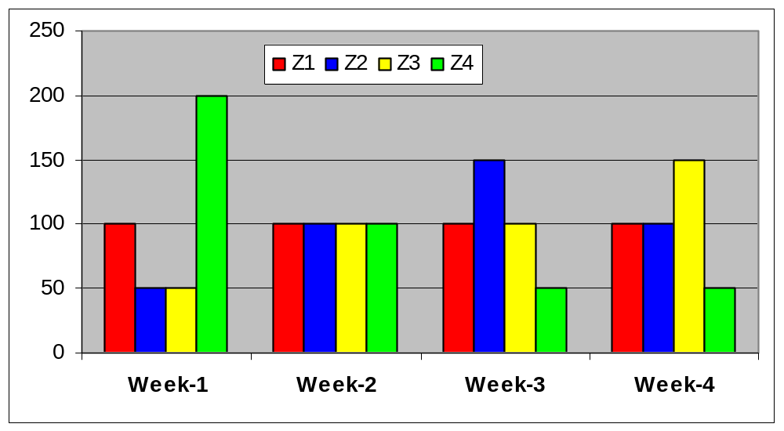
Aggregation hides crucial facts chart
Z1: Sale is constant (need to work on it)
Z2: Sale went up, then fell (need of concern)
Z3: Sale is on the rise, why?
Z4: Sale dropped sharply, need to look deeply.
W2: Static sale

Slide 41
Step 3: Choose Fact Statement
Facts
“We need monthly sales
volume and Rs. by
week, product and Zone”
Dimensions

Slide 42
Step 3: Identify Facts
Aggregates that are critical for business
Remember that best facts are numeric, summarized data, aggregates
Example: Profit, Qty sold, Amunt earned
Must match with the grain
Fact can be repeated in multiple tables
Re-Group the facts
  Facts with same grains and critics should be placed together

Slide 43
Step 4: Identify Dimensions
Are the aspects, which can be used for analyzing facts
Time dimension is compulsory
Dimensions have hierarchies
A dimension can share across schemas
A Tip:
  An attribute can live in only one dimension

Slide 44
Step 5: Identify Relationship
Link dimensions with fact
Resolve many-to-many relationship by adding surrogate key
Relate fact with all possible dimension

Slide 45
Example Case*
GB Video is a members-only video rental organization.
Members join GB Video by filling out an application and giving a credit card as a reference for membership.
When members come into the store they select the particular videos that they want to take and bring them to a clerk to check out.
The clerk completes an electronic rental form for them and calculates the amount of the bill.
Each video has a one day fee, an additional lower rate for extra days, a premium charge for each weekend day, and a charge for late (overdue) returns.
When the customer returns the video, the clerk checks to see if overdue charges apply and returns the video to inventory.

Slide 46
Example Case ERD
Customer
#Cust No
F Name
L Name
Ads1
Ads2
City
State
Zip
Tel No
Expire
Requestor of
Rental
#Rental No
Date
Clerk No
Pay Type
Expire
CC Approval
Line
#Line No
Due Date
Return Date
OD charge
Pay type
Owner of
Requested by
Owned by
Holder of
Held by
Title
#Title No
Name
Vendor No
Cost
Video
#Video No
One-day fee
Extra days
Weekend
Name for
Named by

Slide 47
Building a DM for GB Video
Choose the Business Process
  Select a many-to-many association table as the central fact table for the mart.
  Look for the tables which are capturing transactions.
  If there are more than one association tables in the E-R diagram then the system will probably generate more than one potential Stars
Choose the Grain
  The records in the association/transaction table define the grain of the fact table
  The designer should explicitly describe what that grain is in operational terms
  In this case the grain of the mart is “individual video rental line describing a video rented to a specific customer on a specific rental form”
Cannot go below that

Slide 48
Building DM (Contd.)
Choose the Facts
  The most useful facts are numeric and additive
  Additive facts are those that can be added up across records
  In sales marts like the GB Video mart the most common facts are ‘cost’ and ‘quantity’.
  Most order systems can record price, quantity and cost. Price, for example, is not additive, but quantity and cost are.
  Overdue (OD) charge is an additive fact.
  One-day fee, extra days, and weekend charge are not additive but because change so often that they are better facts than dimensional attributes.

Slide 49
Partial Fact Table
Line
LineID
OD Charge
OneDayCharge
ExtraDaysCharge
WeekendCharge
DaysReserved
DaysOverdue
Now we need to connect this fact table to dimensions.
First it requires finding dimensions and their descriptive attributes.

Slide 50
Building DM (Contd.)
Dimension Tables
  Create dimension tables from entities by promoting foreign keys into the fact table
  For example, the relationship “Requestor of” connecting records in the Customer table to individual Rental occurrences would be implemented by a foreign key in the Rental table.
  Moving that foreign key from the Rental table into the Line table maintains the information content and makes for a simpler query structure.
  Promote dates to the fact table and create a date dimension to replace the actual date value by an ID.

Slide 51
Example Case ERD
Customer
#Cust No
F Name
L Name
Ads1
Ads2
City
State
Zip
Tel No
Expire
Requestor of
Rental
#Rental No
Date
Clerk No
Pay Type
Expire
CC Approval
Line
#Line No
Due Date
Return Date
OD charge
Pay type
Owner of
Requested by
Owned by
Holder of
Held by
Title
#Title No
Name
Vendor No
Cost
Video
#Video No
One-day fee
Extra days
Weekend
Name for
Named by

Slide 52
Dim. Model for GB Video
Customer
CustID
Cust No
First Name
Last Name
Video
VideoID
Video No
Line
LineID
OD Charge
OneDayCharge
ExtraDaysCharge
WeekendCharge
DaysReserved
DaysOverdue
CustID
AddressID
RentalId
VideoID
TitleID
RentalDateID
DueDateID
ReturnDateID
Address
AddressID
Adddress1
Address2
City
State
AreaCode
Phone
Title
TitleID
TitleNo
Name
Cost
Vendor Name
Rental
RentalID
Rental No
Clerk No
Store
Pay Type
Date
DateID
SQLDate
Day
Week
Quarter
Holiday

